Slide 1
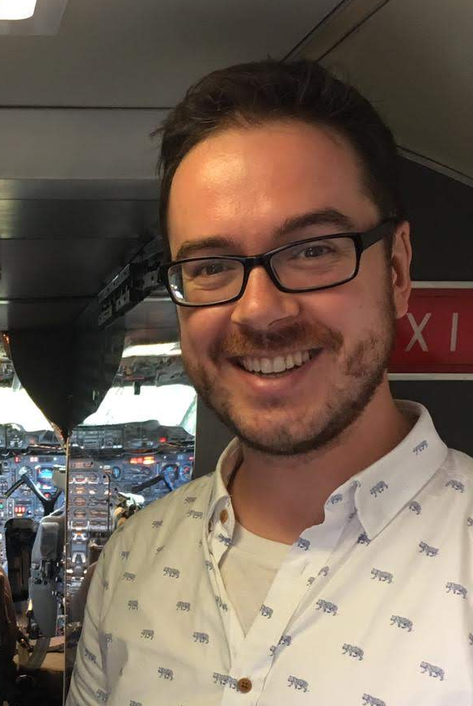
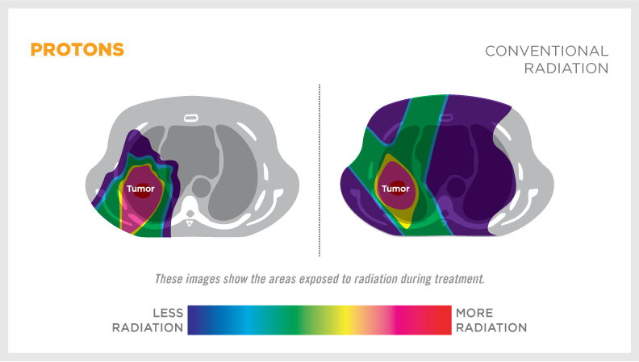
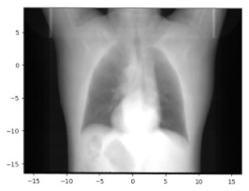

Image guided proton radiography for lung cancer radiotherapy
Beam monitor
Treatment
Imaging
Liquid scintillator
Mirror
CCD Camera

Slide 2





Early results
Image guided proton radiography for lung proton radiotherapy
The alternatives
Methods | Low Dose | Real-Time | In-situ Feedback | Accurate
Image-guided pRad
4D CT
Breath hold/Gating
In room CBCT
Experimental Setup
Established collaboration
Notes:
This research is the first step into what could be a new way of treating patient that have lung cancer, a way that enables a step change in curative rate. This is a high reward project, and

Slide 3
Image guided proton radiography for NSCLC proton radiotherapy
Accelerators
Cameras
 | Cyclotron (ProBeam) | Cyclotron (PSI Gantry 3) | Synchrotron MDA
Energy Layer switching | <1s | 200 ms | 2.1 s
Spot switching time | 200 us | Continuous | 3 ms
Minimal spot time | 3ms | Continuous | 4ms
Time for 100 (10cm²) spots | 320 ms | 125 ms | 700 ms
Time for energy switch | ~1.6 s | 400 ms | 4.2 s
Total time for radiography | 1.92 s | 0.525s | 4.9s
 | Zyla 5.5 CMOS cameras | Andor CCD Luca DL-658 | Oryx 10GigE
Exposure range | 11ms to 30s | 200 ms | 3 us to 30s
Frame rate | 59 (3 tap) or 97 (10 tap) fps | 37 fps | 160 fps
Vast majority of the time is always spent on the energy switching
Cameras are not a limitations, even 37 fps is far from the bottleneck imposed by the energy switching layer.
To note, minimum exposure of the Oryx is 3us, which means you could drastically accelerate the radiograph single-pencil beam process.

Slide 4
Reconstruction methods

Slide 5

4 methods to compare spatial resolution
Old
Distal camera
Need a calibration (Daniel works on that)
Potential artefact due to scattering!
Front tracker single event-
Lateral image Bragg Peak shift
Front tracker Scintillator energy:
Place a tracker at the front of the patient
Gaussian weighting

Slide 6
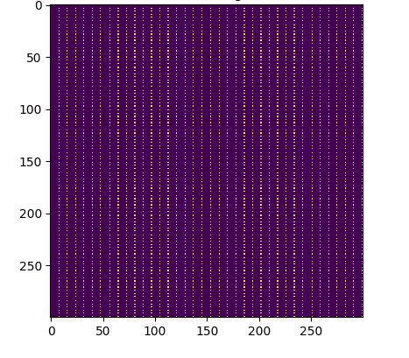
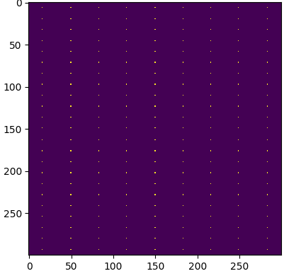
Characteristics of the pencil beam
Old
100x100 or 25x25 grid of pencil beams
0.5 or 1.0 cm standard deviation
100 x 100
25 x 25

Slide 7
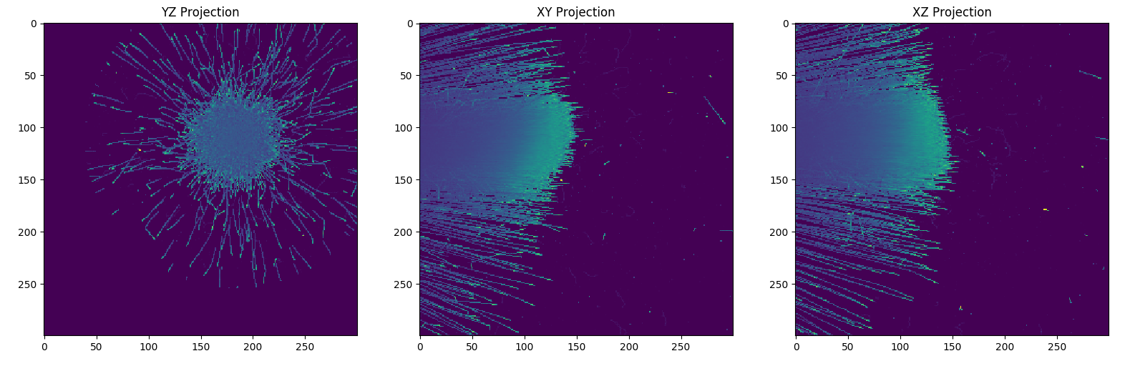
Gaussian Weighting Single Pencil Beam Useful for Distal Camera?
Old
(X,Y)
(X₀,Y₀)

Slide 8
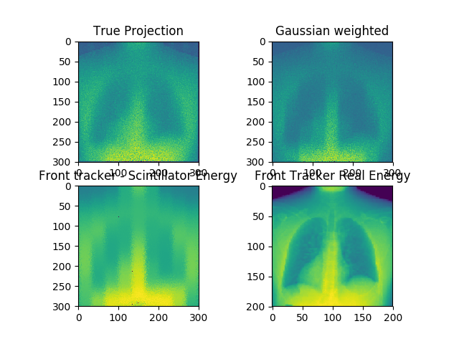
25 x 25 grid 1cm STD
Old

Slide 9
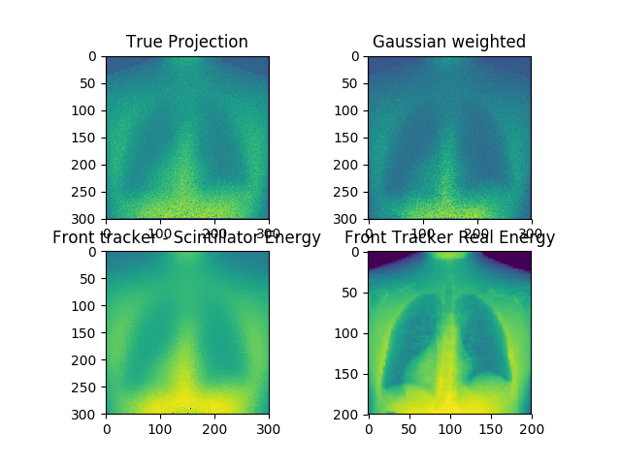
100x100 grid 1cm STD

Slide 10
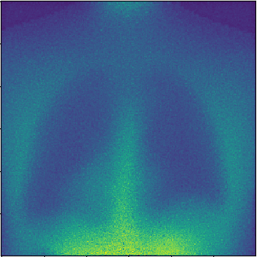
Comparison of Gaussian Weighting
Old
I was not aware of the need for calibration (…)
Might be interesting to redo these test with calibrated data! Or pencil beam by pencil beam.
25x25 1 cm
100x100 1cm
100x100 0.5cm

Slide 11


Optimisation Method Deffet et al. (IBA)
Initial Relation
W
Reference (D_{r})
Measurement (D_{m})
Cost Function
z_{i}
Z

Slide 12
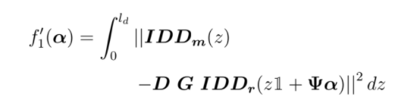
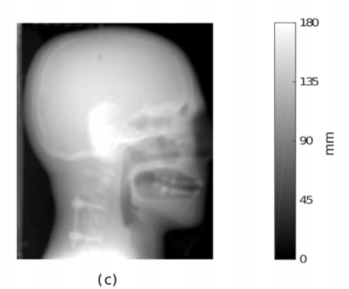
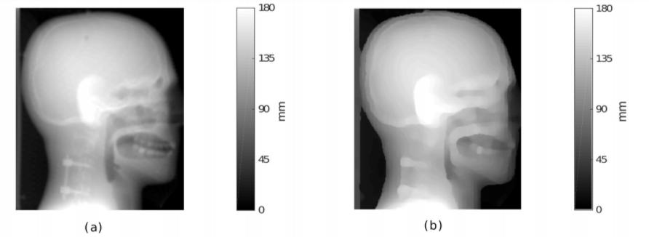
Optimisation Method Deffet et al. (IBA)
Resolution enhancement?
It’s an interpolation!
Results
Ground Truth
No optimisation
Deffet et al.
Acquisition details
Pencil Beam 3mm Sigma
Spot spacing of 5 mm -> Spot density of 4 spot/cm^2
In comparison, Chinmay had 1089 spots in 4cm^2 ~ 250 spot/cm^2?

Slide 13
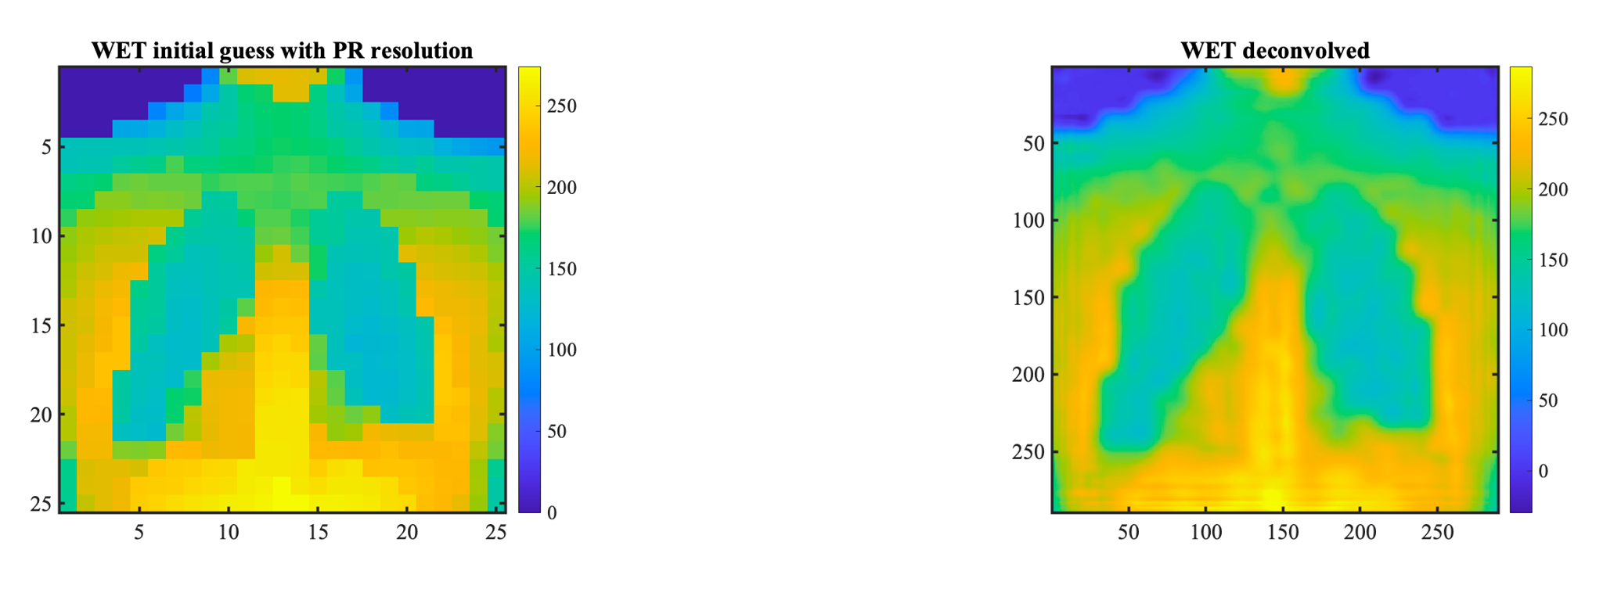
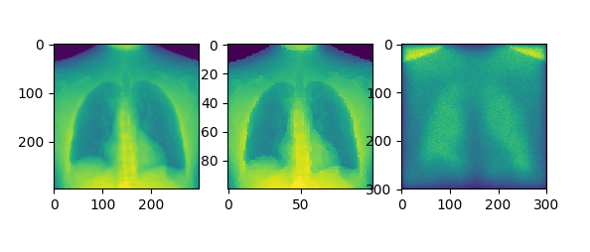
Deffet method -> My implementation
100x100 results looks good results but:
Interpolation play a big role
Do not work well for high gradient changes
Do not work well for low density PB
25x25
100x100

Slide 14
Pro and Cons Deffet
Pros:
Clever usage of curvelet for ill-posed cost function
Can make use of data beyond the PB sampling through the gaussian weighting
Already coded, we have it.
Cons:
Cost-function does not accurately represent the physics
Not easily transferable to higher dimension detector (e.g. ours)
Using 1-D information means we have less info for a given dose, or more dose for a given image quality

Slide 15
Our method – Diffusion Proton CT
- First step is to redefine the problem based on scattering
Voxelized Phantom
EJ-260 Scintillator
Distal Camera
(2.2b)
Z
Y
30 cm
X
Lateral Camera (2.2c-d)

Slide 16
Few definitions
K-th phantom voxel
r_{k}
Voxelized Phantom
EJ-260 Scintillator
D-th
detector voxel r_{d}
I-th PB
r_{i}
Distal Camera
(2.2b)
Z
Y
30 cm
X
Lateral Camera (2.2c-d)

Slide 17
Scattering Pencil Beam -> Voxel
I-th PB
r_{i}
Exaggerated lateral
diffusion

Slide 18
Scattering Pencil Beam -> Voxel
I-th PB
r_{i}
Exaggerated lateral
diffusion

Slide 19

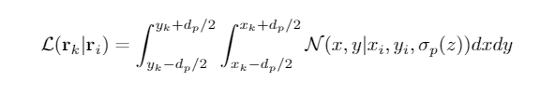
Scattering Pencil Beam -> Voxel
I-th PB
r_{i}
Exaggerated lateral
diffusion

Slide 20

Scattering Voxel -> Detector
EJ-260 Scintillator
D-th detector voxel
r_{d}
Distal Camera
(2.2b)
Z
Y
30 cm
X
Lateral Camera (2.2c-d)

Slide 21

Combined Scattering
EJ-260 Scintillator
I-th PB
r_{i}

Slide 22

Scattering Voxel -> 1-D Detector
Examples:
MLIC
ZEBRA
NEMO
Averaged scintillator
30 cm
X

Slide 23

Scattering Voxel -> 2-D Detector
Examples:
Our system
Tanaka et al.
Y
30 cm
X

Slide 24

Scattering Voxel -> 3-D Detector
Examples:
None so far?
Z
30 cm
Y
X

Slide 25
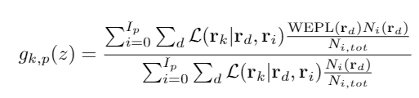
Back-projection operator in diffusion pCT

Slide 26
Back-projection operator in diffusion pCT
For all pencil beam
in a projection
For all detector element
for a pencil beam
Fraction of a
PB in detector element (fuzzy)
Contributions to the k-th voxel
By the p-th projection
Normalization

Slide 27
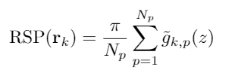
Back-projection operator in diffusion pCT
For all pencil beam
in a projection
For all detector element
for a pencil beam
Fraction of a
PB in detector element (fuzzy)
Contributions to the k-th pixel
By the p-th projection
Normalization
Back-projection operator
Ramp-filtered back-projection

Slide 28
Currently – In reconstruction

